Slide 1
Requirements Elicitation and Analysis
N.H. Madhavji
University of Western Ontario
Lecture based on the book by Kotonya & Sommerville
N.H. Madhavji

Slide 2
Requirements Elicitation and Analysis
Chapter 3

Slide 3
Objectives
To describe the processes of requirements elicitation and analysis.
To introduce a number of requirements elicitation and requirements analysis techniques.
To discuss how prototypes may be used in the RE process.

Slide 4
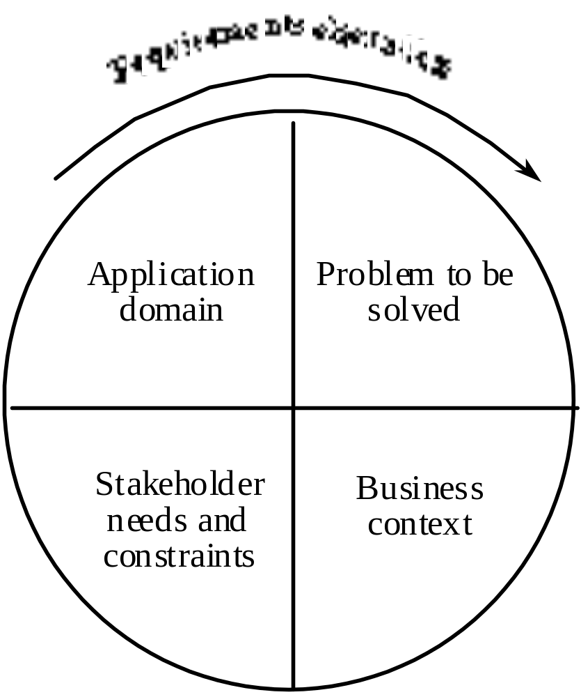
Components of requirements elicitation

Slide 5
Elicitation activities
Application domain understanding
  Application domain knowledge is knowledge of the general area where the system is applied.
Problem understanding
  The details of the specific customer problem where the system will be applied must be understood.
Business understanding
  You must understand how systems interact and contribute to overall business goals.
Understanding the needs and constraints of system stakeholders
  You must understand, in detail, the specific needs of people who require system support in their work.

Slide 6
A comment on the sequence
Domain understanding ->
    Problem understanding ->
    Customer’s Business understanding ->
    Customer’s Needs & constraints understanding.
In my opinion, these are all interleaved components. For example, improved problem understanding can lead to improved domain understanding; improved business understanding can lead to improved problem understanding; etc. There can be zig-zag and backtracking.
The real world can be quite complex!
N.H. Madhavji

Slide 7
What about past releases?
An important issue during requirements elicitation can be the existence of the current system for which new requirements need to be enhanced.
This is not dealt with adequately in the pedagogical literature.
Research is very thin on this issue also.
Think about trying to “extend” an existing building without actually considering the constraints (and the opportunities) it might provide!
N.H. Madhavji

Slide 8
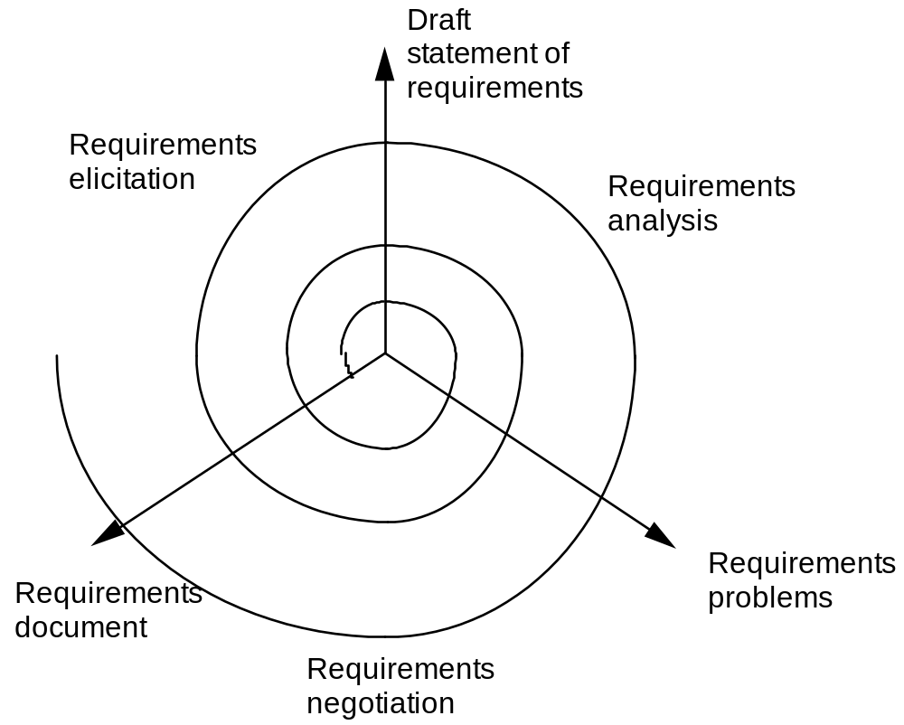
Elicitation, analysis and negotiation

Slide 9
Again: Zig-zagging & Backtracking
N.H. Madhavji

Slide 10
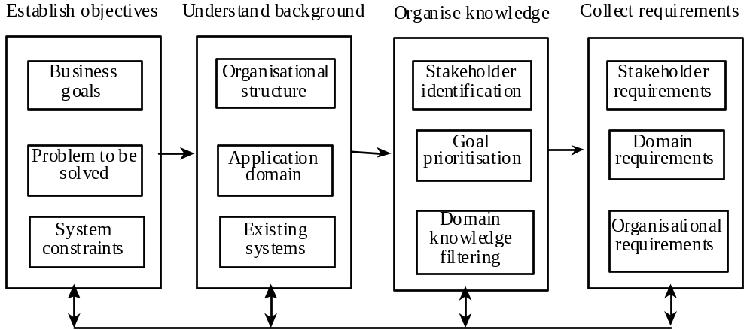
The requirements elicitation process

Slide 11
Elicitation stages
Objective setting
  The organisational objectives should be established including general goals of the business, an outline description of the problem to be solved, why the system is necessary and the constraints on the system.
Background knowledge acquisition
  Background information about the system includes information about the organisation where the system is to be installed, the application domain of the system and information about existing systems
Knowledge organisation
  The large amount of knowledge which has been collected in the previous stage must be organised and collated.
Stakeholder requirements collection
  System stakeholders are consulted to discover their requirements.

Slide 12
The requirements elicitation process
Many only think of THIS as Requirements Elicitation.
[Very limited!]
N.H. Madhavji

Slide 13
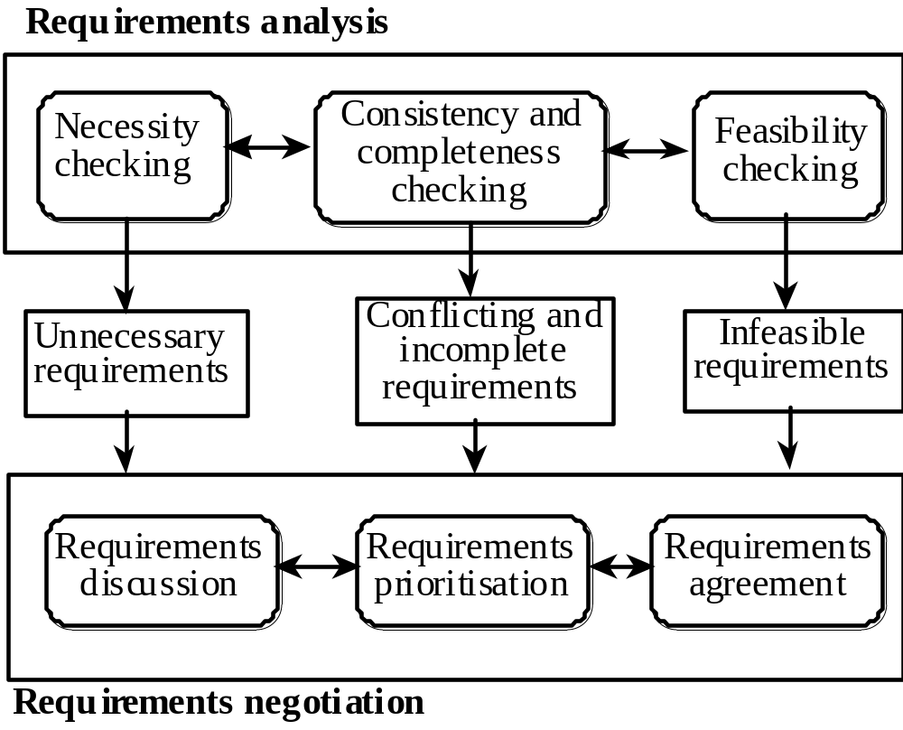
Requirements analysis and negotiation

Slide 14
Analysis checks
Necessity checking
  The need for the requirement is analysed. In some cases, requirements may be proposed which don’t contribute to the business goals of the organisation or to the specific problem to be addressed by the system.
Consistency and completeness checking
  The requirements are cross-checked for consistency and completeness. Consistency means that no requirements should be contradictory; completeness means that no services or constraints which are needed have been missed out.
Feasibility checking
  The requirements are checked to ensure that they are feasible in the context of the budget and schedule available for the system development.

Slide 15
Requirements negotiation
Requirements discussion
  Requirements which have been highlighted as problematical are discussed and the stakeholders involved present their views about the requirements.
Requirements prioritisation
  Disputed requirements are prioritised to identify critical requirements and to help the decision making process.
    NHM: even non-disputed requirements that are agreed upon need to be prioritised!
Requirements agreement
  Solutions to the requirements problems are identified and a compromise set of requirements are agreed. Generally, this will involve making changes to some of the requirements.

Slide 16
Requirements analysis and negotiation
Expect Backtracking!!!
N.H. Madhavji

Slide 17
Elicitation techniques
Specific techniques which may be used to collect knowledge about system requirements
This knowledge must be structured
  Partitioning - aggregating related knowledge
  Abstraction - recognising generalities
  Projection - organising according to perspective
Elicitation problems
  Not enough time for elicitation
  Inadequate preparation by engineers
  Stakeholders are unconvinced of the need for a new system
(or Decomposition)
Organisational politics!
N.H. Madhavji

Slide 18
Specific elicitation techniques
Interviews
Scenarios
Soft systems methods
Observations and social analysis
Requirements reuse

Slide 19
Interviews
The requirements engineer or analyst discusses the system with different stakeholders and builds up an understanding of their requirements.
Types of interview
  Closed interviews. The requirements engineer looks for answers to a pre-defined set of questions
  Open interviews There is no predefined agenda and the requirements engineer discusses, in an open-ended way, what stakeholders want from the system.
Often, it is mixed.
N.H. Madhavji

Slide 20
Interviewing essentials
Interviewers must be open-minded and should not approach the interview with pre-conceived notions about what is required
Stakeholders must be given a starting point for discussion. This can be a question, a requirements proposal or an existing system
Interviewers must be aware of organisational politics - many real requirements may not be discussed because of their political implications

Slide 21
Scenarios
Scenarios are stories which explain how a system might be used. They should include
  a description of the system state before entering the scenario
  the normal flow of events in the scenario
  exceptions to the normal flow of events
  information about concurrent activities
  a description of the system state at the end of the scenario
Scenarios are examples of interaction sessions which describe how a user interacts with a system
Discovering scenarios exposes possible system interactions and reveals system facilities which may be required

Slide 22
Library scenario - document ordering
Log on to EDDIS system
Issue order document command
Enter reference number of the required document
Select a delivery option
Log out from EDDIS
This sequence of events can be illustrated in a diagram

Slide 23
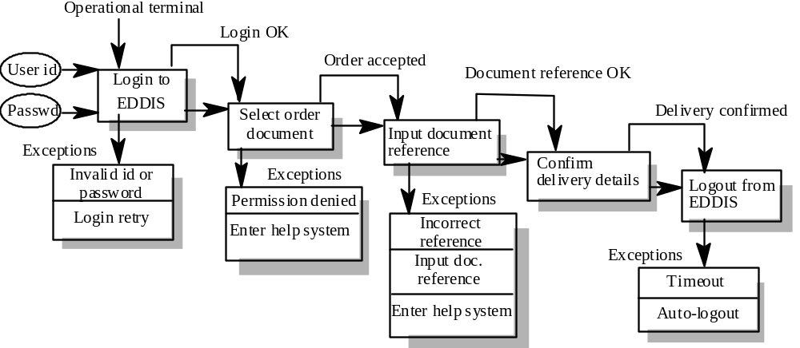
Library Scenario

Slide 24
Scenarios and OOD
Scenarios are an inherent part of some object-oriented development methods
The term use-case (i.e. a specific case of system usage) is sometimes used to refer to a scenario
There are different views on the relationship between use-cases and scenarios:
  A use-case is a scenario
  A scenario is a collection of use-cases. Therefore, each exceptional interaction is represented as a separate use-case

Slide 25
Soft Systems methods
These produce informal models of a socio-technical system. They consider the system, the people and the organisation
Not techniques for detailed requirements elicitation. Rather, they are ways of understanding a problem and its organisational context
Software Systems Methodology (SSM) is probably the best known of these methods
The essence of SSM is its recognition that systems are embedded in a wider human and organisational context

Slide 26
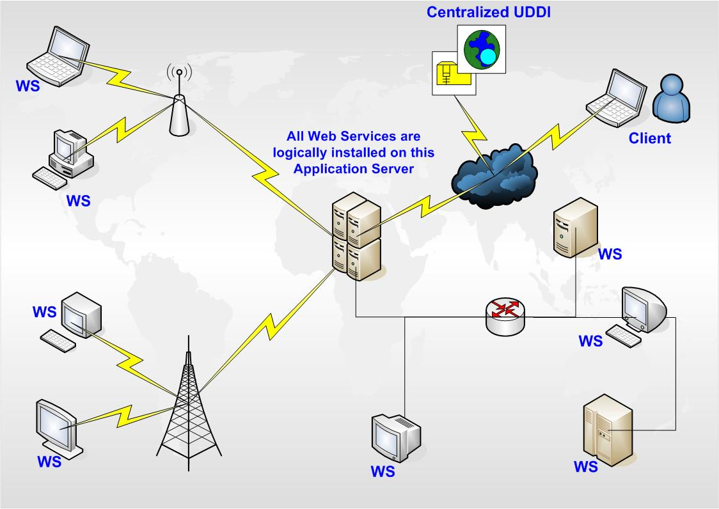
© Ksherdil - Madhavji

Slide 27
Stages of SSM
Problem situation assessment
Problem situation description
Abstract system definition from selected viewpoints
Conceptual system modelling
Model/real-world comparison
Change identification
Recommendations for action
N.H. Madhavji

Slide 28
Observation and social analysis
People often find it hard to describe what they do because it is so natural to them. Sometimes, the best way to understand it is to observe them at work
Ethnography is a technique from the social sciences which has proved to be valuable in understanding actual work processes
Actual work processes often differ from formal, prescribed processes
An ethnographer spends some time observing people at work and building up a picture of how work is done

Slide 29
Ethnography guidelines
Assume that people are good at doing their job and look for non-standard ways of working
Spend time getting to know the people and establish a trust relationship
Keep detailed notes of all work practices. Analyse them and draw conclusions from them
Combine observation with open-ended interviewing
Organise regular de-briefing session where the ethnographer talks with people outside the process
Combine ethnography with other elicitation techniques

Slide 30
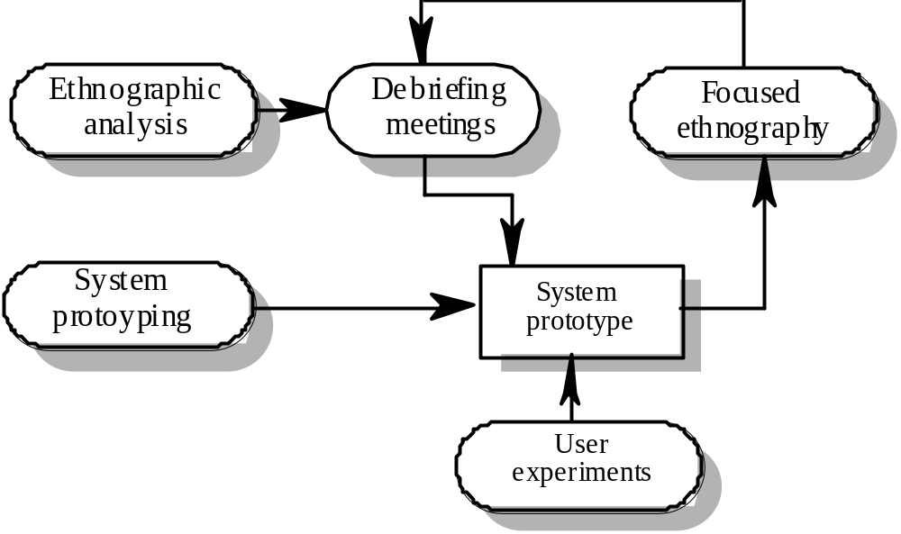
Ethnography in elicitation
activity
system

Slide 31
Ethnographic perspectives
The work setting viewpoint
  This describes the context and the physical location of the work and how people use objects to carry out tasks. Therefore, in a study of a help desk (say), this would describe the objects which the helper had to hand and how these were organised.
Social and organisational perspectives
  This tries to bring out the day-to-day experience of work as seen by different people who are involved. Each individual typically sees the work in a different ways and this viewpoint tries to organise and integrate all of these perceptions.
The workflow viewpoint
  This viewpoint presents the work from a series of work activities with information flowing from one activity to another.

Slide 32
Requirements reuse
Reuse involves taking the requirements which have been developed for one system and using them in a different system
Requirements reuse saves time and effort as reused requirements have already been analysed and validated in other systems
Currently, requirements reuse is an informal process but more systematic reuse could lead to larger cost savings

Slide 33
Reuse possibilities
Where the requirement is concerned with providing application domain information.
Where the requirement is concerned with the style of information presentation. Reuse leads to a consistency of style across applications.
Where the requirement reflects company policies such as security policies.
Reuse of certain non-functional requirements
(e.g., platform requirements).
Note, particularly, the rationale for the original
requirements. Are they still valid?
N.H. Madhavji

Slide 34
Prototyping
A prototype is an initial version of a system which may be used for experimentation
Prototypes are valuable for requirements elicitation because users can experiment with the system and point out its strengths and weaknesses. They have something concrete to criticise
Rapid development of prototypes is essential so that they are available early in the elicitation process

Slide 35
Prototyping benefits
The prototype allows users to experiment and discover what they really need to support their work
Establishes feasibility and usefulness before high development costs are incurred
Essential for developing the ‘look and feel’ of a user interface
Can be used for system testing and the development of documentation
Forces a detailed study of the requirements which reveals inconsistencies and omissions

Slide 36
Types of prototyping
Throw-away prototyping
  intended to help elicit and develop the system requirements.
  The requirements which should be prototyped are those which cause most difficulties to customers and which are the hardest to understand. Requirements which are well-understood need not be implemented by the prototype.
Evolutionary prototyping
  intended to deliver a workable system quickly to the customer.
  Therefore, the requirements which should be supported by the initial versions of this prototype are those which are well-understood and which can deliver useful end-user functionality. It is only after extensive use that poorly understood requirements should be implemented.

Slide 37
Prototyping costs and problems
Training costs - prototype development may require the use of special purpose tools
Development costs - depend on the type of prototype being developed
Extended development schedules - developing a prototype may extend the schedule although the prototyping time may be recovered because rework is avoided
Incompleteness - it may not be possible to prototype critical system requirements

Slide 38
Approaches to prototyping
Paper prototyping
  a paper mock-up of the system is developed and used for system experiments
‘Wizard of Oz’ prototyping
  a person simulates the responses of the system in response to some user inputs
Executable prototyping
  a fourth generation language or other rapid development environment is used to develop an executable prototype

Slide 39
Executable prototype development
Fourth generation languages based around database systems
Visual programming languages such as Visual Basic or ObjectWorks
Internet-based prototyping solutions based on World Wide Web browsers and languages such as Java

Slide 40
Requirements analysis
Information loss during the RE and SA phases is considered the most severe form of software information loss [1]. Furthermore, the cost of solving information loss through rework in earlier stages of development is significantly less than in the later stages [7] [➔NHM: is ref 7 OK here? – please check. There is an older ref by Boehm in 1976 I believe if ref 7 is not OK – check with me]. Given that rework costs can be in excess of 50% of total development costs in very large projects [7] [➔NHM: is ref 7 OK here???], it is prudent to reduce these costs by minimising rework later in the project.
The goal of analysis is to discover problems, incompleteness and inconsistencies in the elicited requirements. These are then fed back to the stakeholders to resolve them through the negotiation process
Analysis is interleaved with elicitation as problems are discovered when the requirements are elicited
A problem checklist may be used to support analysis. Each requirement may be assessed against the checklist

Slide 41
Analysis checklists
Premature design
  Does the requirement include premature design or implementation information?
Combined requirements
  Does the description of a requirement describe a single requirement or could it be broken down into several different requirements?
Unnecessary requirements
  Is the requirement ‘gold plating’? That is, is the requirement a cosmetic addition to the system which is not really necessary.
Use of non-standard hardware
  Does the requirement mean that non-standard hardware or software must be used? To make this decision, you need to know the computer platform requirements.

Slide 42
Analysis checklists
Conformance with business goals
  Is the requirement consistent with the business goals defined in the introduction to the requirements document? Requirements ambiguity
Requirements ambiguity
  Is the requirement ambiguous i.e. could it be read in different ways by different people? What are the possible interpretations of the requirement?
Requirements realism
  Is the requirement realistic given the technology which will be used to implement the system?
Requirements testability
  Is the requirement testable, that is, is it stated in such a way that test engineers can derive a test which can show if the system meets that requirement?

Slide 43
Requirements interactions
A very important objective of requirements analysis is to discover the interactions between requirements and to highlight requirements conflicts and overlaps
A requirements interaction matrix shows how requirements interact with each other. Requirements are listed along the rows and columns of the matrix
  For requirements which conflict, fill in a 1
  For requirements which overlap, fill in a 1000
  For requirements which are independent, fill in a 0

Slide 44
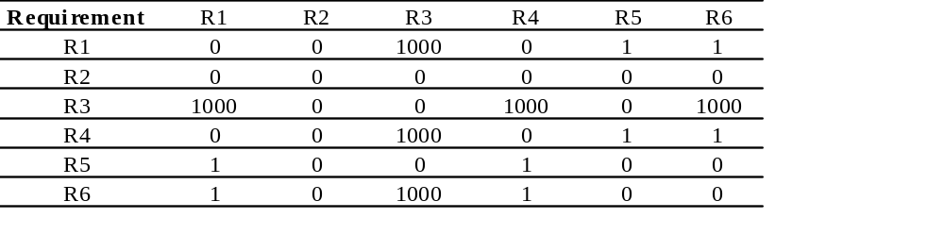
Interaction matrices

Slide 45
Requirements negotiation
Disagreements about requirements are inevitable when a system has many stakeholders. Conflicts are not ‘failures’ but reflect different stakeholder needs and priorities
Requirements negotiation is the process of discussing requirements conflicts and reaching a compromise that all stakeholders can agree to
In planning a requirements engineering process, it is important to leave enough time for negotiation. Finding an acceptable compromise can be time-consuming

Slide 46
Negotiation meetings
An information stage where the nature of the problems associated with a requirement is explained.
A discussion stage where the stakeholders involved discuss how these problems might be resolved.
  All stakeholders with an interest in the requirement should be given the opportunity to comment. Priorities may be assigned to requirements at this stage.
A resolution stage where actions concerning the requirement are agreed.
  These actions might be to delete the requirement, to suggest specific modifications to the requirement or to elicit further information about the requirement.

Slide 47
Key points
Requirements elicitation involves understanding the application domain, the specific problem to be solved, the organisational needs and constraints and the specific facilities needed by system stakeholders.
The processes of requirements elicitation, analysis and negotiation are iterative, interleaved processes which must usually be repeated several times.
There are various techniques of requirements elicitation which may be used including interviewing, scenarios, soft systems methods, prototyping and participant observation.

Slide 48
Key points
Prototypes are effective for requirements elicitation because stakeholders have something which they can experiment with to find their real requirements.
Checklists are particularly useful as a way of organising the requirements validation process. They remind analysts what to look for when reading through the proposed requirements.
Requirements negotiation is always necessary to resolve requirements conflicts and remove requirements overlaps. Negotiation involves information interchange, discussion and resolution of disagreements.

